Slide 1
EMIT Camera Model
Christine Bradley
2 April 2022

Slide 2
VA 902899
Requirement Name: Spectral Sampling
Requirement ID: 748433
Work Conducted by: David R. Thompson, EMIT Instrument Scientist
Christine Bradley, EMIT Optics CAM
Date Work Performed: December 2021
Reviewed and concurred by:
Requirement Statement: The EMIT instrument spectral sampling shall be ≤ 10 nm at all wavelengths.
Verification statement:
Using a series of lasers, the wavelength calibration of which is known with high accuracy, we confirmed that the channel spacing of EMIT is always less than 10 nm. Confirmatory plots are shown on the following slides.

Slide 3
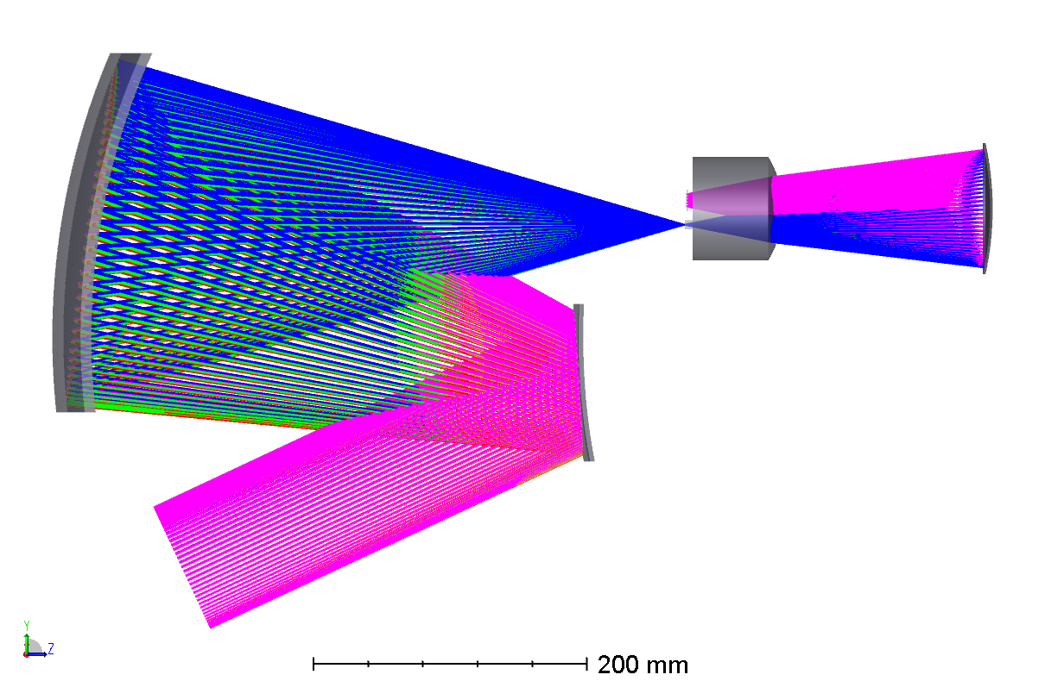
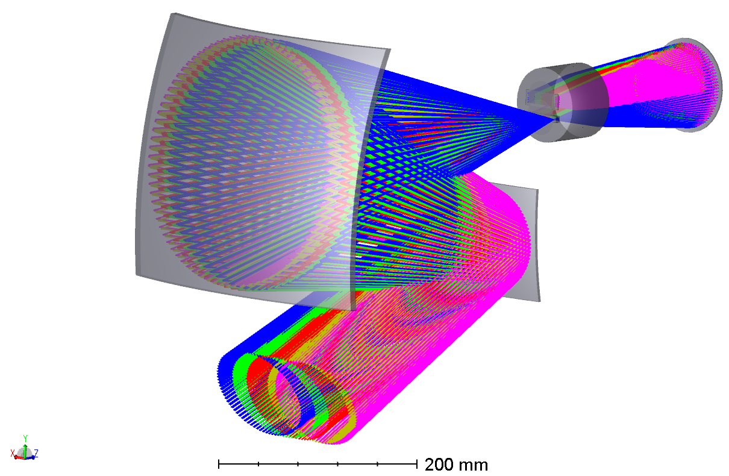
EMIT Optics Coordinate Frame
+Z
+Z
Direction of curvature
+X
Along-track direction
Optics y-direction
Cross-track direction
Optics x-direction
+Y
+Y

Slide 4
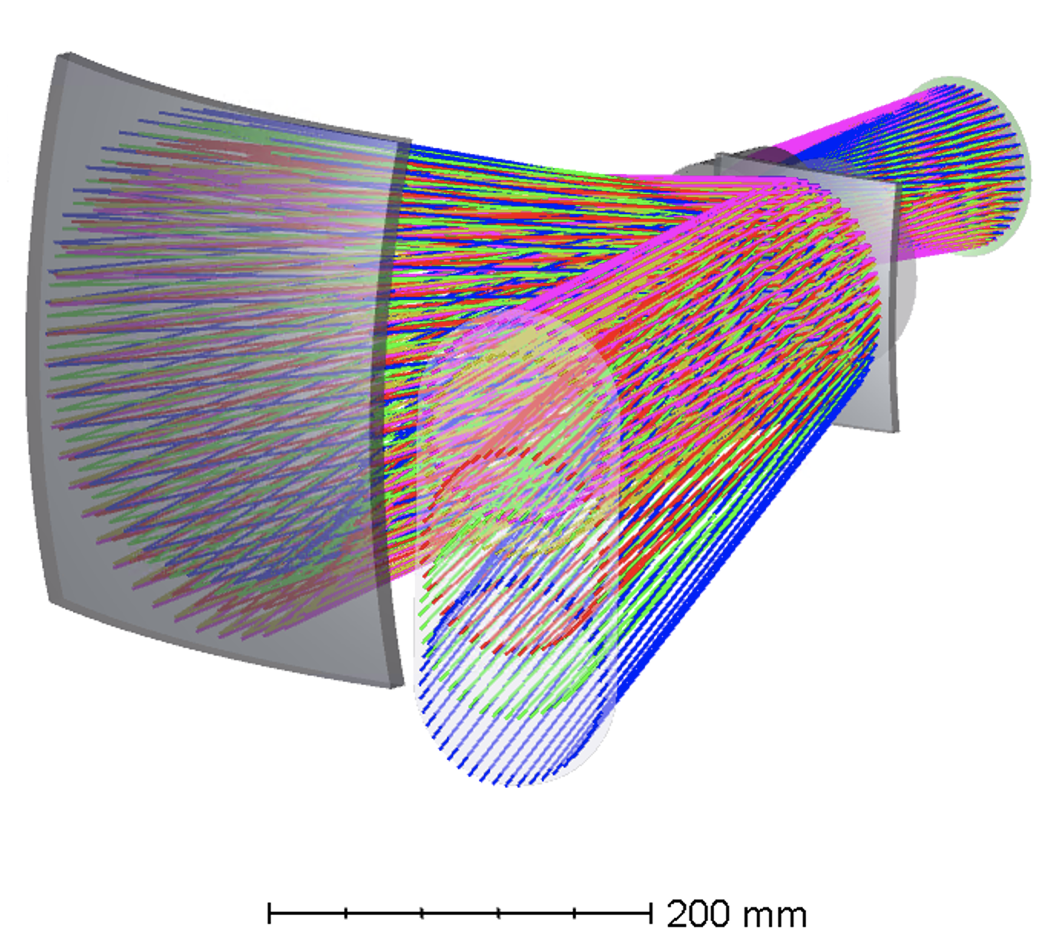
EMIT Optics Coordinate Frame Continued
as-built values
Cross-track FOV | 11.0431° | 1240 pixels
Cross-track IFOV | 155 micro-radians | 1 pixel
Along-track IFOV | 172 micro-radians | 1 pixel
pink rays show the positive extent of the FOV (positive x-field angle in spreadsheet)
blue rays show the negative extent of the FOV (negative x-field angle in spreadsheet)
+X
+Y

Slide 5
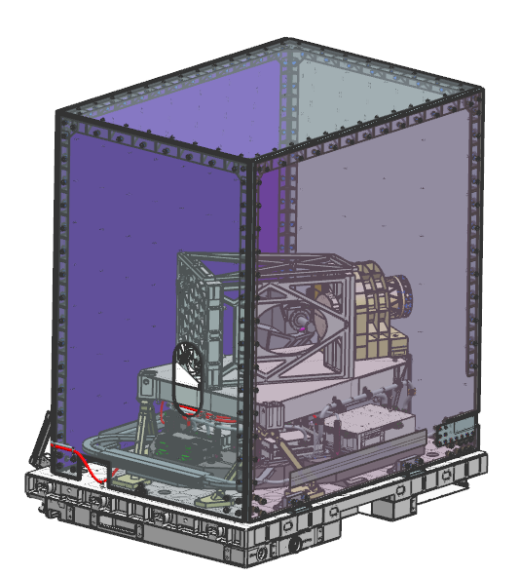
Fields Angles WRT Instrument
Starboard
(cross-track direction)
Curvature is oriented such that the edge field angles are leading the center field angle (0°) in pushbroom scan
Ram
(along-track direction)
Nadir

Slide 6
Camera Model Spreadsheet
Spreadsheet contains four sheets
Field_X: corresponds to the cross-track direction of EMIT
Field_Y: corresponds to the along-track direction of EMIT
Cen_X: corresponds to the x-position on the FPA in Zemax coordinates (used by Christine to determine correct spatial pixel number)
Cen_Y: corresponds to the y-position on the FPA in Zemax coordinates (used by Christine to determine correct spectral pixel number)
For each sheet, the field angle is reported for a given spatial pixel and spectral pixel position. Sheets are organized by the following:
Row: spatial pixel
Column: spectral pixel
As-built data and measurements during TVAC were used to update the Zemax Optical Model. The optical model includes measured smile and keystone effects and are built in to the reported Field_X and Field_Y values.

